Slide 1






Sapphire Bank

Slide 2



The Ask where we started

Slide 3

Agenda
Objective of the Training
Framework for 8 Weeks
Overview
Our Journey
Tools Used
Problem definition
Challenges
Scope and conclusion
Our Team
Demo

Slide 4

Objective of the Training
Become a Full Stack developer by gaining all the skills required to work with front-end and back-end technologies.

Slide 5

Framework for 8 Weeks
1
Database Concepts and SQL
Introduction to Applications
2
Object Oriented Programming
Data Structures Core Java Programming
3
Project- Banking Application
JDBC and Web Design fundamentals
4
Html, CSS,
Bootstrap, AJAX
5
Java Script, ES5, ES6, Angular7
UML Diagrams
6
Architecture, framework of angular.
JEE Architecture
40 Days- 280 Hours of Training
7
JSP Servlet
Spring REST( Core & MVC) myBatis
8
Project Presentation

Slide 6
Overview
DBMS
Tomcat
Angular7
OOPs
Java script
Structured Query Language
GitHub
Maven
Jsp and Servlet
Spring Rest
HTML,CSS
Core JAVA
Agile Methodology
Jenkins

Slide 7

Our Journey

Slide 8
Sapphire Bank
Project-Banking Application
Low Level Diagrams- Use Case , Class, Application Flow.
Data Base Schema Design
Architecture of Banking Application.
UI Structure using Angular7( HTML/CSS/JS).
Backend Structure using JAVA, Spring Rest, Database
Build and test project using Jenkins.

Slide 9
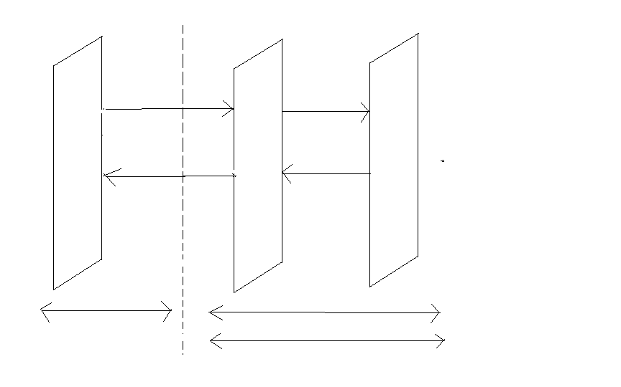
Full Stack Architecture
Angular7
HTML/CSS/JS
Java/Spring
iBatis/Hibernate
Xml HTTP Request
Browser
ORM/Database
DB
UI/UX
BC(Spring Boot)
Xml HTTP Request
Node JS
REST API
Node JS
Tomcat /Jetty
Front End Development

Slide 10










BACKEND
DevOps
DATA
FRONTEND

Slide 11
Overview of ABC Bank Management Application
These are the various job positions within Bank System. The positions are as follows:
Superuser
Admin
Agent
Customer

Slide 12
ABC Bank Management Application
ABC Bank Application allows us to perform all banking related CRUD operations.
Our use case deals with all agent operations.

Slide 13
Problem Definition
To view the customer details ,view transactions of the customer, view update and delete agent profile and approve customer.

Slide 14


Slide 15
Scope and Conclusion
Scope
This project can be implemented in any bank for fulfilling the basic need
Conclusion
This bank management application will allow the customers to create the account,delete the account and manage all his transactions and it also allows the admin and agent to examine the transaction going inside bank without manual processing.

Slide 16
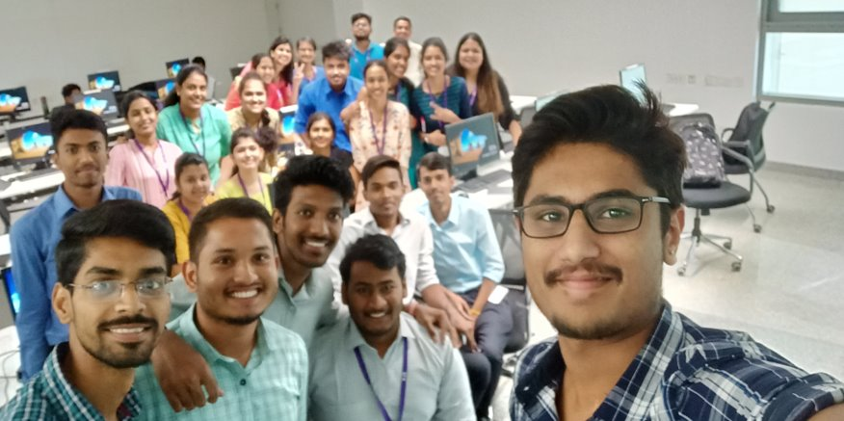
Our Team

Slide 17

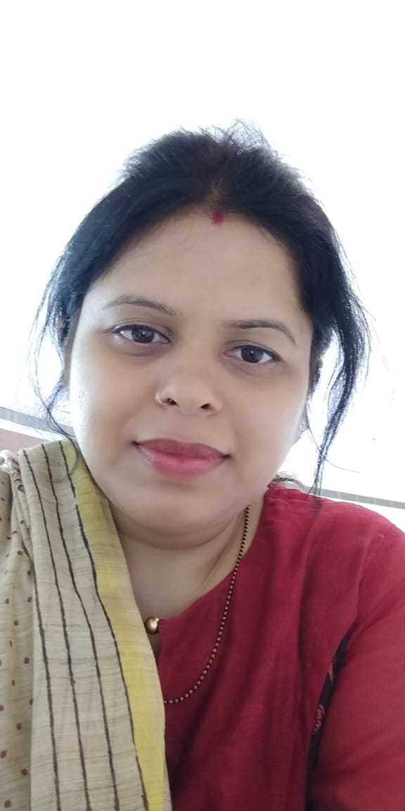

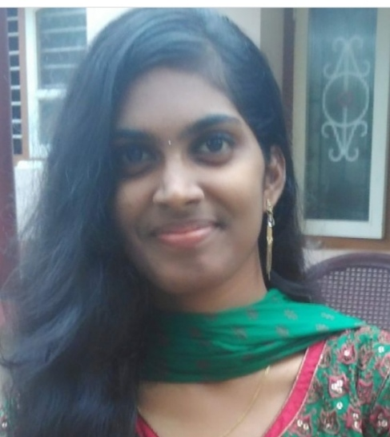
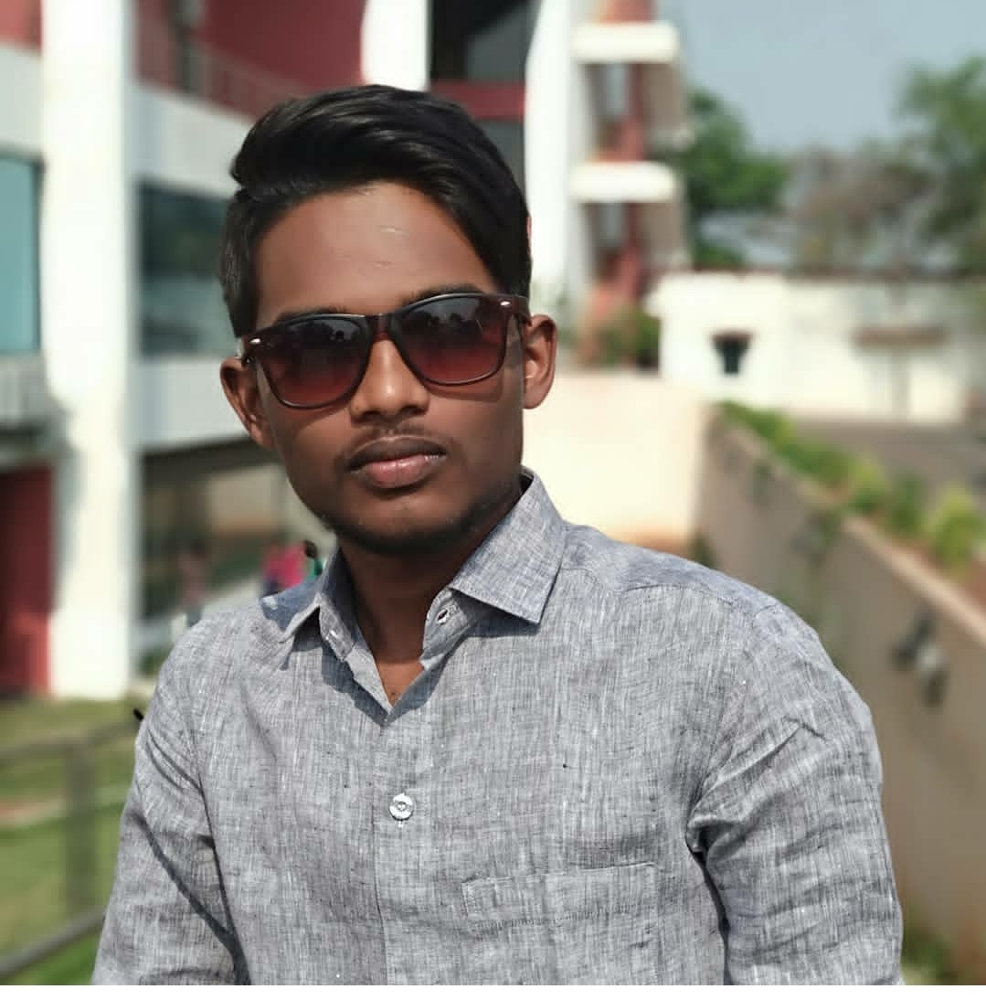
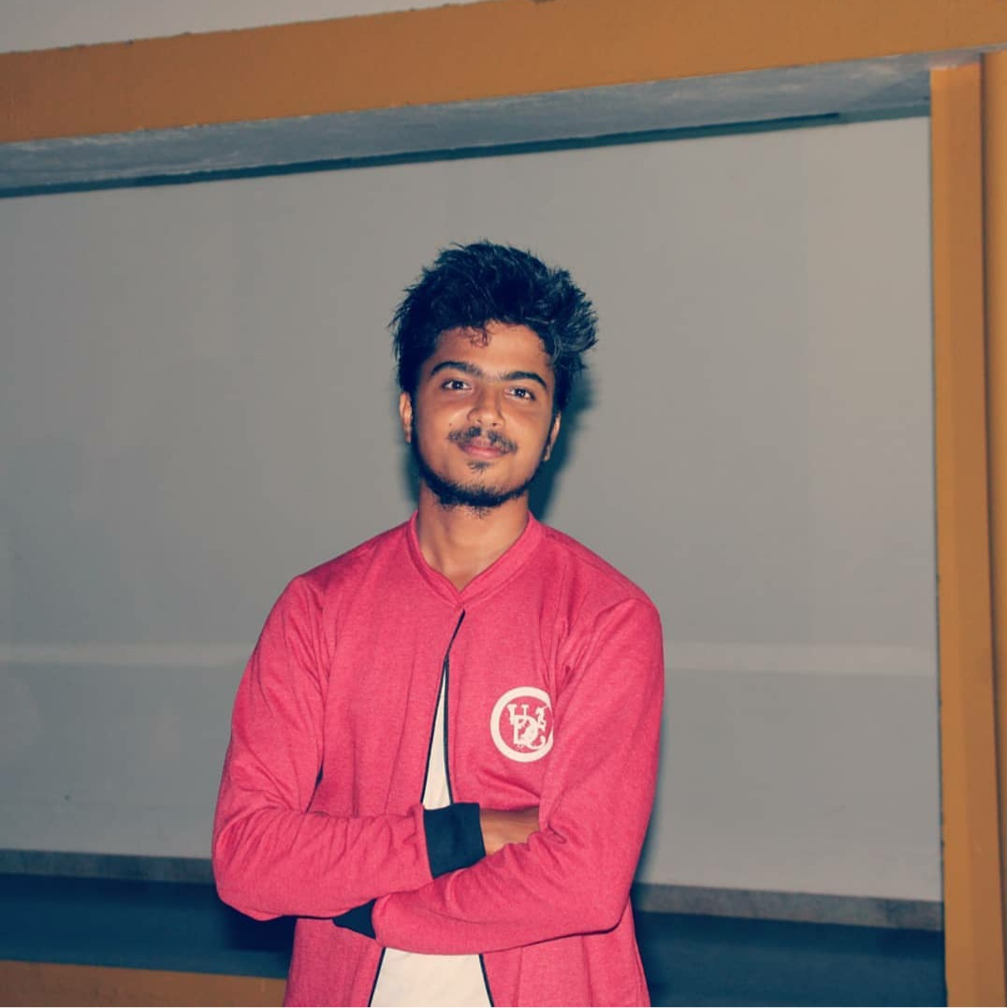
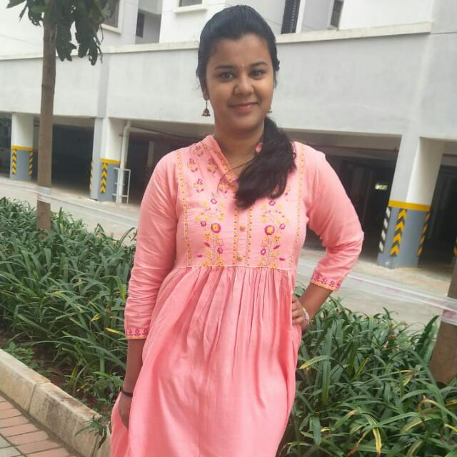
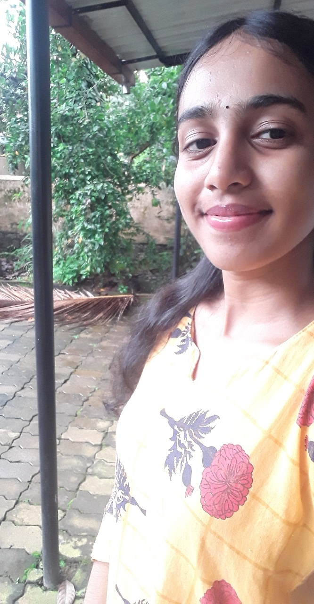
Team Sapphire
Trainers
Upasana
Kavita
Amit Balyan
Vikas B
Nikitha Shetty
Shravan Kini
Soumya Jakati
Rachana Bhandary

Slide 18
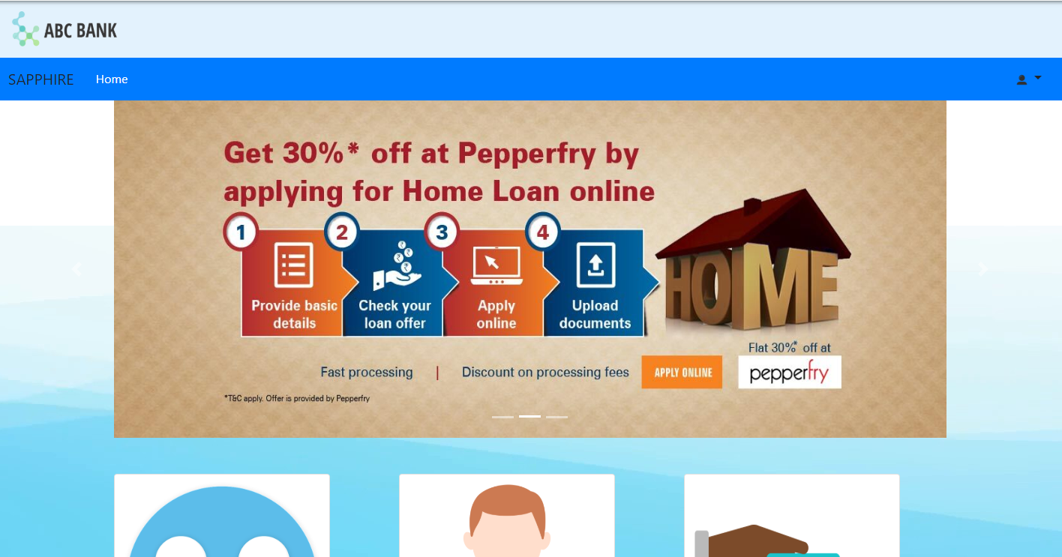

Agent Page Screenshot

Slide 19


